Slide 1
Caring for Older People With HIV: Challenges and Best Practices
Coming of Age with HIV
AIDS 2018
Amsterdam
Eugenia L. Siegler, MD
els2006@med.cornell.edu

Slide 2
I have support from an investigator-initiated research grant from Gilead Sciences.

Slide 3
Good News: There are Too Many Programs to Talk About!
Background
Descriptions and examples
Lessons

Slide 4
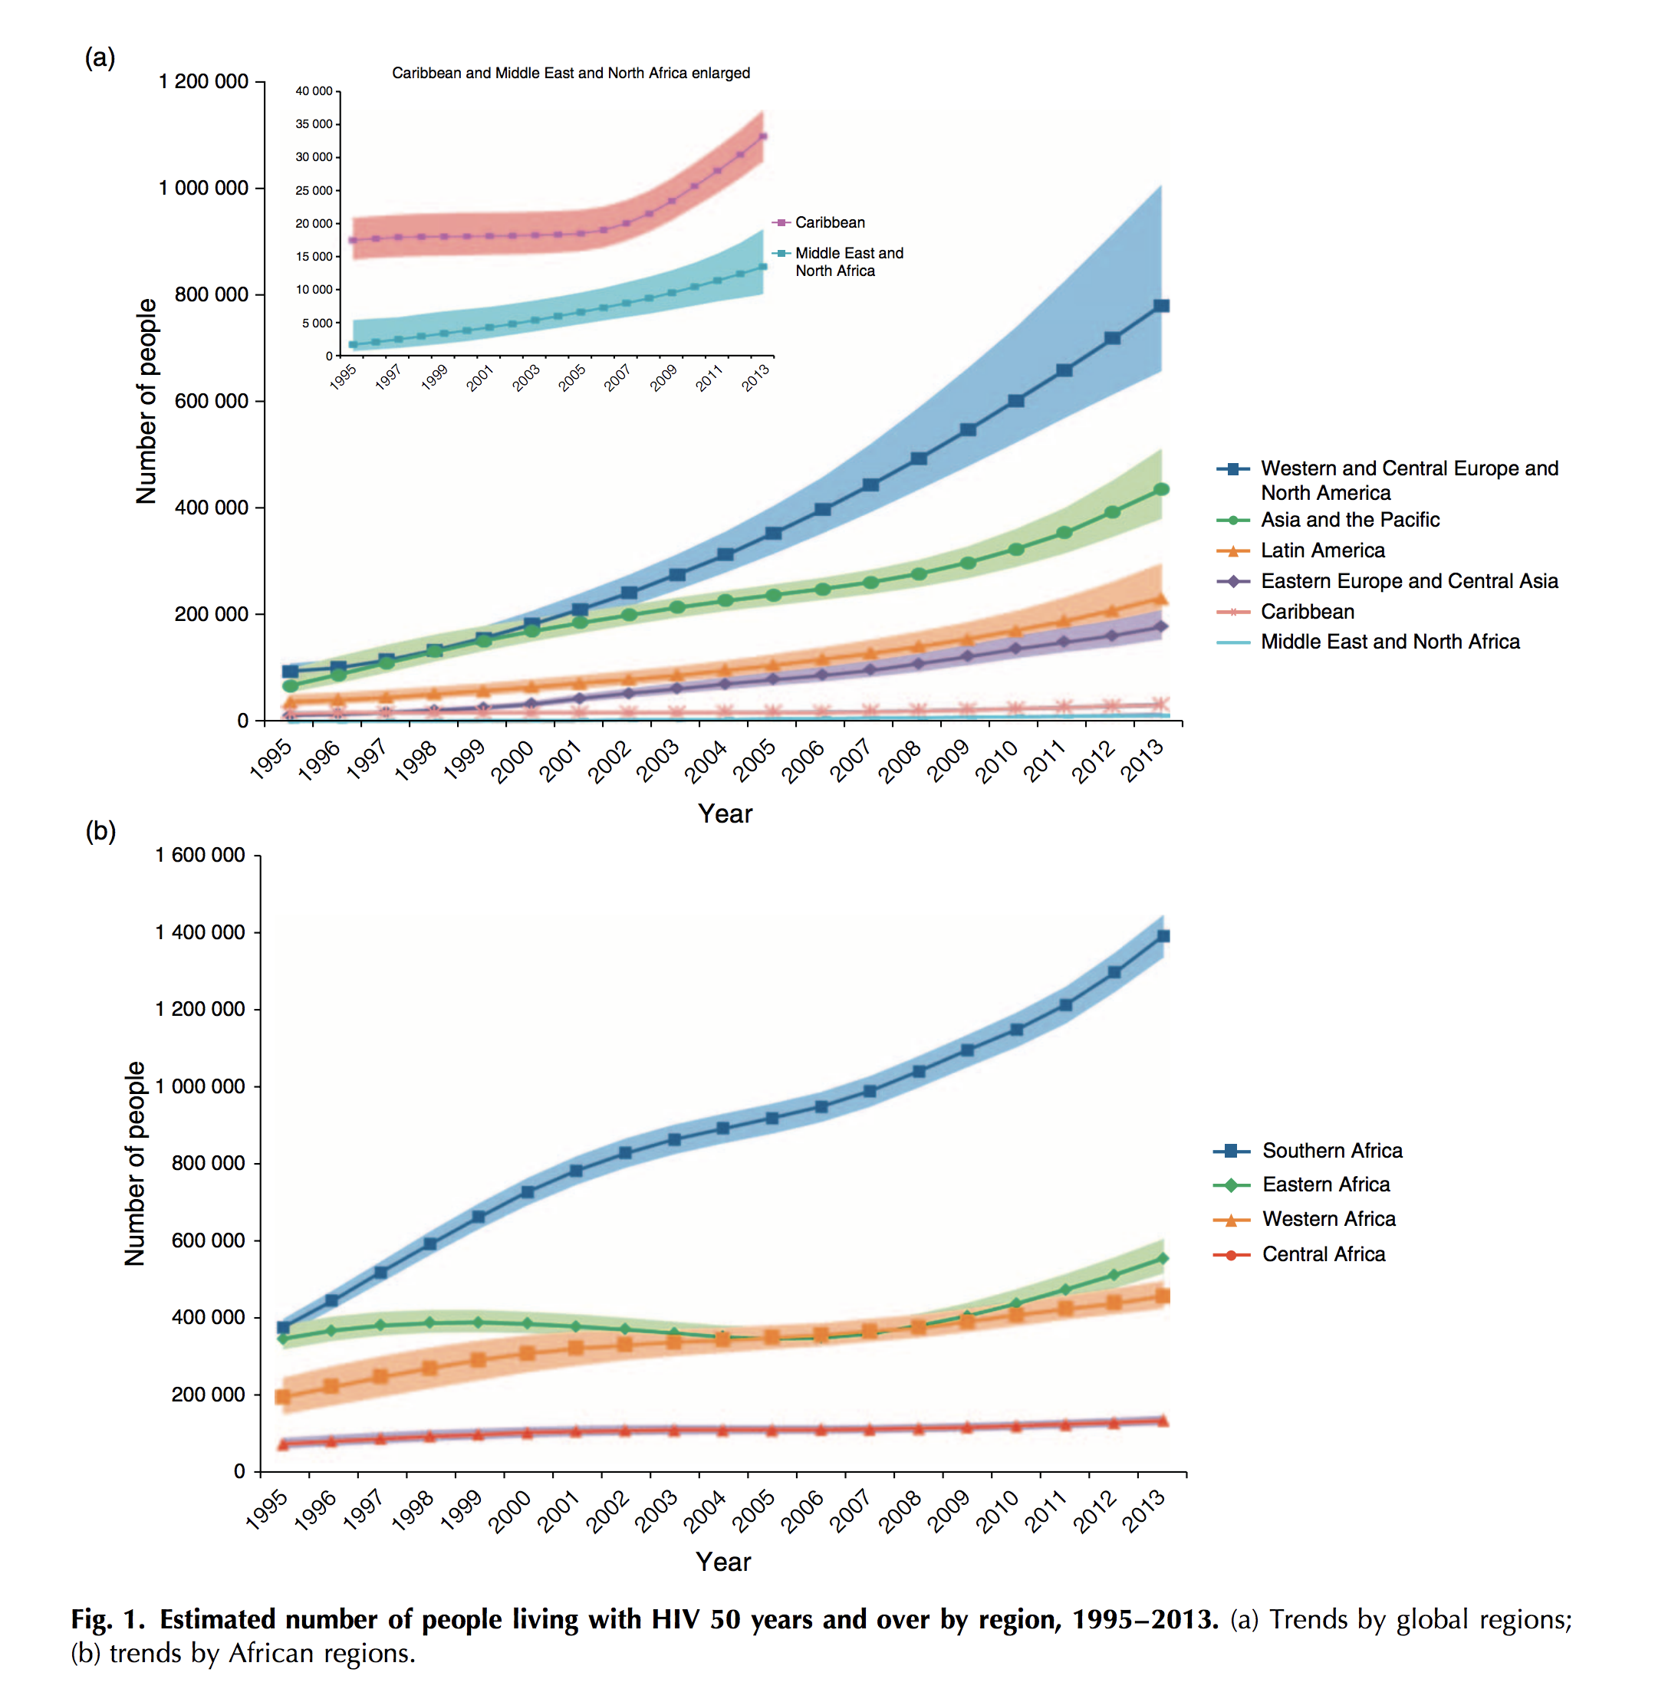
People With HIV Are Aging.
Everywhere.
How do we best meet their needs?
Mahy et al. AIDS 2014, 28 (Suppl 4):S453–S459

Slide 5
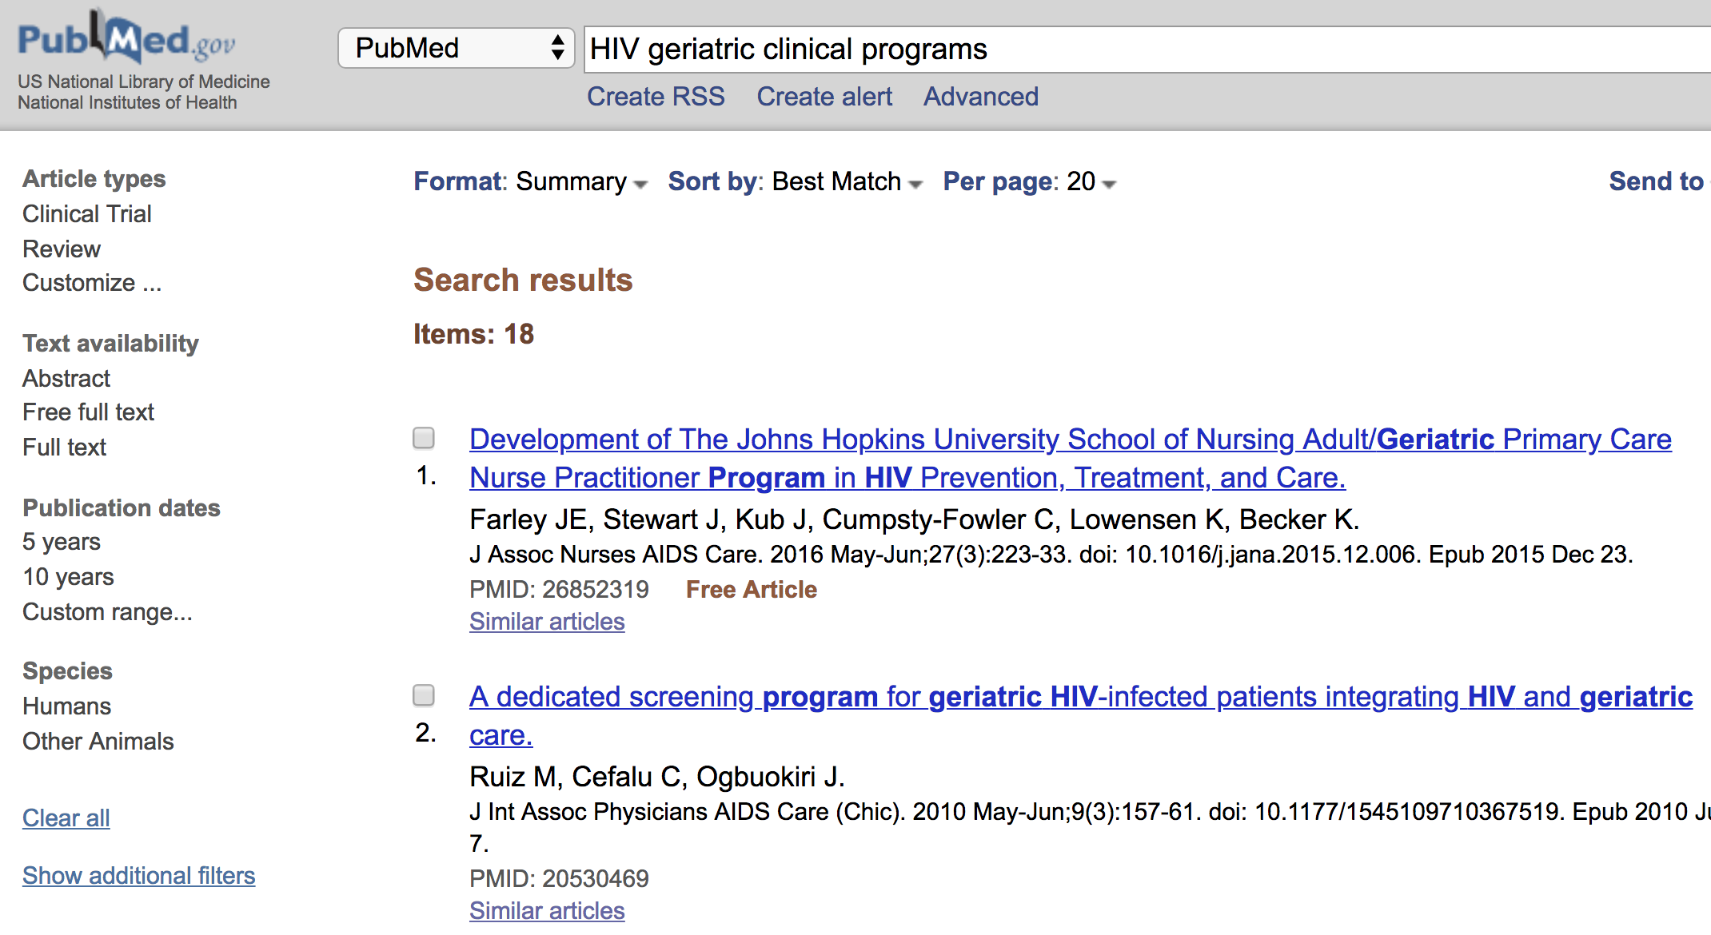
Methodology: Availability Sampling
Searched Pubmed and Google with terms "geriatric HIV programs", "HIV and Aging Clinical Programs” and countries
Emailed primary author on any study I found
Followed up on personal contacts, referrals
Did not include intervention research or prospective cohorts

Slide 6

Mmuta Team: Sustainability is Not Guaranteed
Ruiz et al. J Int Assoc Phys AIDS Care. 2010;9(3):157-61. PMID: 20530469
Expertise
Screening Process
Criteria for Referral
Specific therapy for identified needs
Formal program ended when providers left, but it has left a legacy

Slide 7
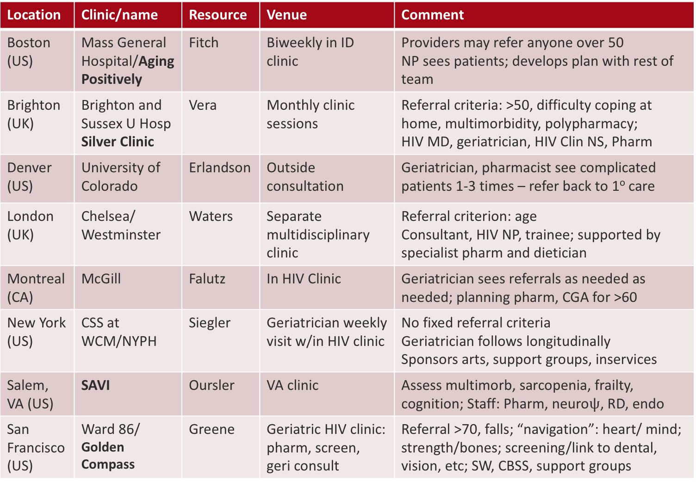
Most Common Model is Consultative Clinic
Location | Clinic/name | Resource | Venue | Comment
Boston (US) | Mass General Hospital/Aging Positively | Fitch | Biweekly in ID clinic | Providers may refer anyone over 50 NP sees patients; develops plan with rest of team
Brighton (UK) | Brighton and Sussex U Hosp Silver Clinic | Vera | Monthly clinic sessions | Referral criteria: >50, difficulty coping at home, multimorbidity, polypharmacy; HIV MD, geriatrician, HIV Clin NS, Pharm
Denver (US) | University of Colorado | Erlandson | Outside consultation | Geriatrician, pharmacist see complicated patients 1-3 times – refer back to 1º care
London (UK) | Chelsea/ Westminster | Waters | Separate multidisciplinary clinic | Referral criterion: age Consultant, HIV NP, trainee; supported by specialist pharm and dietician
Montreal (CA) | McGill | Falutz | In HIV Clinic | Geriatrician sees referrals as needed as needed; planning pharm, CGA for >60
New York (US) | CSS at WCM/NYPH | Siegler | Geriatrician weekly visit w/in HIV clinic | No fixed referral criteria Geriatrician follows longitudinally Sponsors arts, support groups, inservices
Salem, VA (US) | SAVI | Oursler | VA clinic | Assess multimorb, sarcopenia, frailty, cognition; Staff: Pharm, neuro$ψ$, RD, endo
San Francisco (US) | Ward 86/ Golden Compass | Greene | Geriatric HIV clinic: pharm, screen, geri consult | Referral >70, falls; “navigation”: heart/ mind; strength/bones; screening/link to dental, vision, etc; SW, CBSS, support groups

Slide 8
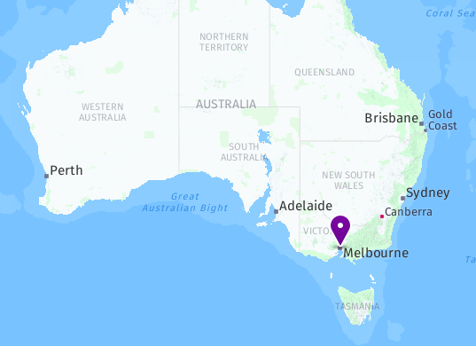
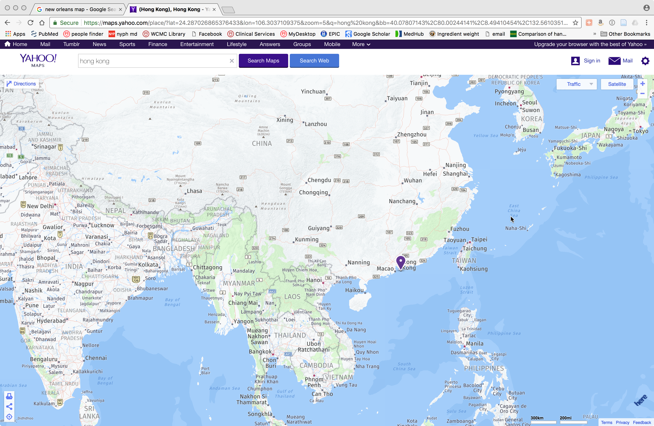
Metabolic Programs Evolved to Manage Greater Complexity of OPH by Expanding from Comorbidity to Geriatric Syndromes
Guaraldi:
University of Modena and Reggio Emilia, Modena, Italy
Hoy:
Alfred Hospital/Monash University, Melbourne
Lui:
Chinese University of Hong Kong

Slide 9
Some Developing Programs Are Starting with Screening;
Some Grow From Cohorts
http://myantarlife.blogspot.com/search/label/sprouting%20seed%20resources
Location | Director | Program | Focus
Barcelona | Negredo | Germans Trias I Pujol University Hospital | Comprehensive geriatric assessment of all patients 60+
Cleveland | Kalayjian Van Epps | Metrohealth VA Hospital | VA: screen for cog impairment, frailty Metrohealth: screen for depression
Durham, NC | McKellar | Duke University | (cohort) to add physical function assess.
Mexico City | Ávila-Funes | Instituto Nacional de Ciencias Médicas y Nutrición Salvador Zubirán | (cohort) MD to receive training abroad; will start specialized service in 2020
Philadelphia | Krain | U. of Pennsylvania | Will have embedded dual trained geri/ID
Porto Allegre, BR | Sprinz | Universidade Federal do Rio Grande do Sul | Age specific screening/exams; referral to subspecialists; pharmacy consultation
San Diego | Karris | Univ. California SD | Screening for IADL impairment; referral to geriatrician

Slide 10
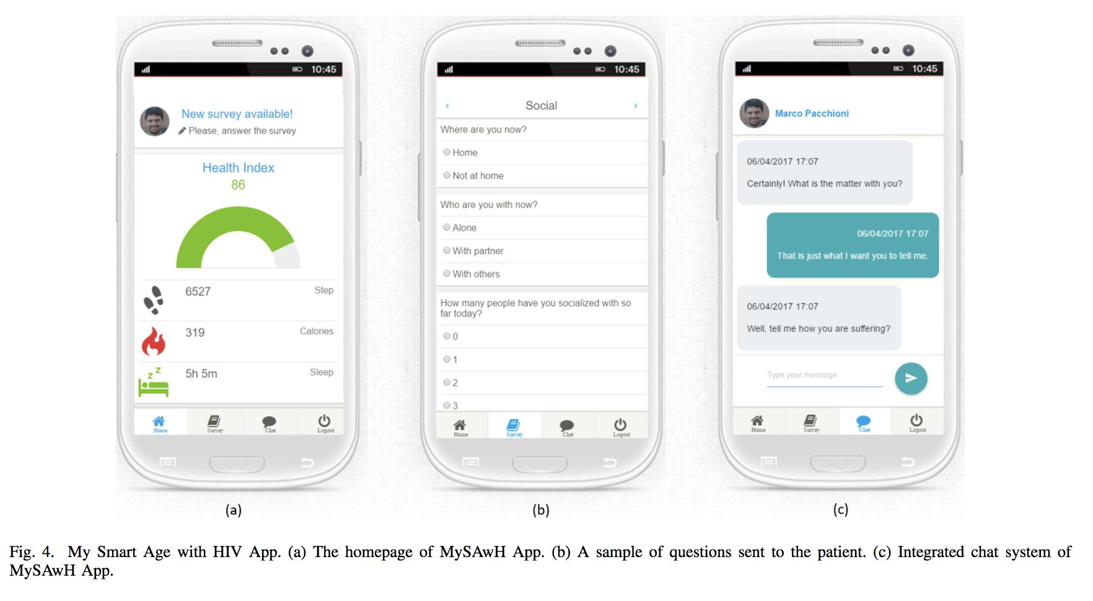
Reaching Outside the Office to Engage OPH:
Mobile Technology is Under Study
https://www.mysmartage.org/
Orsini et al. 2018. https://zapdf.com/my-smart-age-with-hiv-an-innovative-mobile-and-iomt-framewor.html
Virtual passport for OPH based on French National HIV guidelines for screening and exams
Frédéric Bastides- University Hospital of Tours

Slide 11
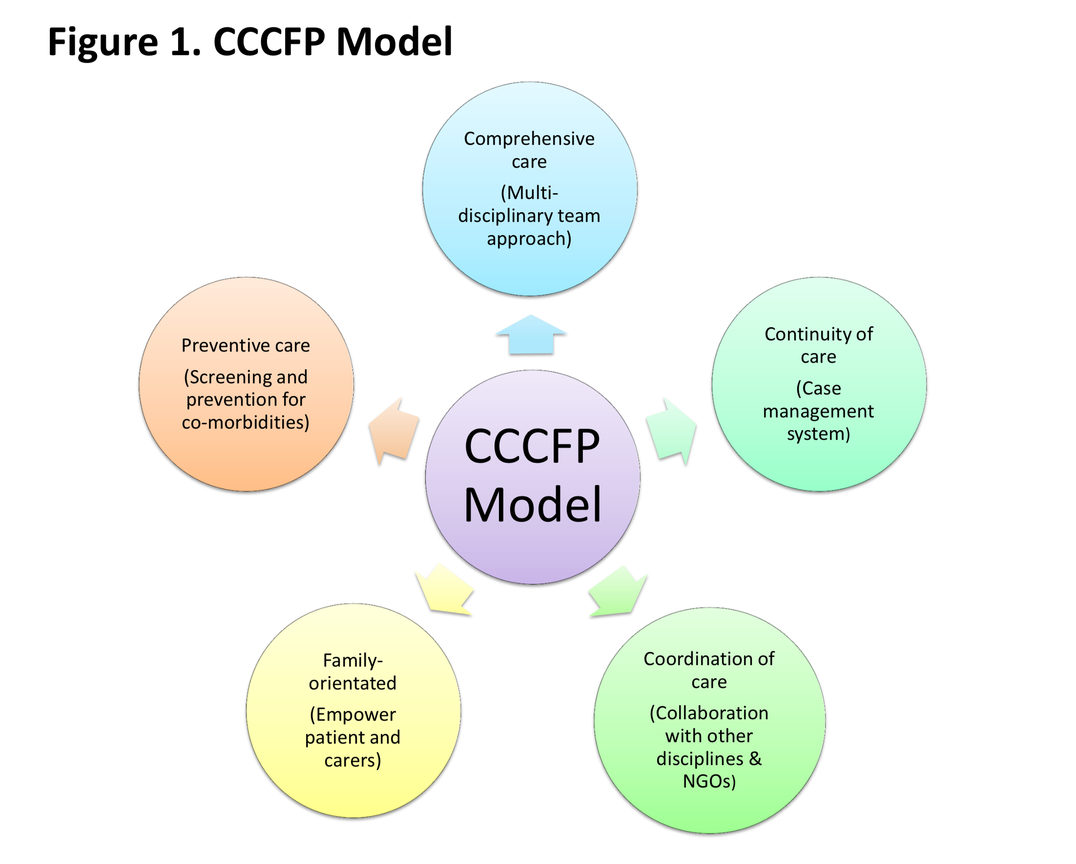

Reaching Outside the Office to Engage OPH:
Case Management Offers a Different Lens
Are we too focused on comorbidity and screening at the expense of effective social interventions?

Slide 12
Resource-Rich and Resource-Limited Countries May Differ in Approaches to Aging and Comorbidity
Maximize Function, Fine-tune Comorbidity Management and Prevent Polypharmacy
V.
Ensure Access to Subspecialty Care
Warriner et al ID Clin NA, 2014; 28, 457-476
For Many, Linkage to HIV Care is Linkage to Chronic Care
Manne-Goehler et al. JAIDS Volume 75(5), 15 August 2017, p 561–567

Slide 13
While Structure and Goals May Differ, Programs Share Common Barriers
http://www.nreionline.com/finance-investment/firpta-changes-herald-increased-real-estate-investment-funding
Tenuous finances
Lack of expertise
Inexact targeting
Insufficient buy-in
Unclear outcomes
Inadequate social resources
https://goo.gl/images/iwZSD8

Slide 14
We have no best practices for caring for older people with HIV.
We can learn from the challenges faced by different programs

Slide 15
To Be Determined
Referral Criteria/Prescreen
Age? Social Supports
Comorbidity (specific or number)
Assessment
Tools
Length
Frailty/function
Staffing/Location
Focus/Feedback
Management of diseases
Reduction/ prevention of frailty
Outcome
Geriatrician or other specialist
Nursing, social work, pharmacy
Linkages
Relationship to primary care
Community organizations
Long term care
Embedded or freestanding
Criteria for success
Financial viability
Improving supports
Referral

Slide 16
Thank You to My Correspondents
Country | Name | Program
Canada | Julian Falutz | McGill University, Montréal
 | Madeleine Durand | Canadian HIV and Aging Cohort
Mexico | José A. Ávila Funes | Nat. Inst. of Med. Sci. & Nutrition Salvador Zubirán, Mexico City
Brazil | Eduardo Sprinz | Universidade Federal do Rio Grande do Sul, Porto Alegre
 | Beatriz Grinsztejn | Instituto de Pesquisa Clínica Evandro Chagas, Rio de Janeiro
Netherlands | Peter Reiss | University of Amsterdam
England | Jaime Vera | Brighton and Sussex
 | Marta Boffito | Chelsea and Westminster
France | Clotilde Allavena | CHU Hôtel Dieu, 44 093 Nantes
 | Jacqueline Capeau | Faculte´ de medecine Pierre et Marie Curie site Saint-Antoine, Paris
 | Frédéric Bastides | University of Tours
Spain | Eugènia Negredo | Germans Trias i Pujol University Hospital, Barcelona
Australia | Jennifer Hoy | Alfred Hospital and Monash University, Melbourne
Malaysia | Reena Rajasuriar | University of Malaya, 50603 Kuala Lumpur
Hong Kong | Grace Lui Man-Po Lee | Chinese University of Hong Kong Queen Elizabeth Hospital
New Zealand | Ngaire Kerse Stephen Neville | University of Auckland Auckland University of Technology
Thailand | Anchalee Avihingsanon | HIV-NAT; Pathumwan, Bangkok
Name | Program (US)
Dorcas Baker | Johns Hopkins (lead)
Ceryl Besch | Louisiana State University, New Orleans
Kristine Erlandson | University of Colorado, Denver
Kathleen Fitch | Massachusetts General Hospital, Boston
Meredith Greene | Golden Compass (UCSF), San Francisco
Amy Justice | Yale/New Haven VAMC
Robert Kalayjian | MetroHealth Hospital, Cleveland
Maile Karris | University of California, San Diego
Alysa Krain | University of Pennsylvania, Philadelphia
Mehri McKellar | Duke University, Durham
Kris Ann Oursler | SAVI (U Maryland – Baltimore VAMC; Virginia Tech – Salem VAMC)
Miriam Rabkin, Tiffany Harris | Columbia University, New York Info re: sub-Saharan Africa
Amy Weinberg | GSI
Sanyu Mojola | University of Michigan - Info re: South Africa
Annette Sohn | UCSF, AmFAR, TreatAsia

Slide 17
Selected References
Greene M, Covinsky KE, Valcour V, et al. Geriatric Syndromes in Older HIV-Infected Adults. J Acquir Immune Defic Syndr. 2015 Jun 1;69(2):161-7. PMID: 26009828.
Harris TG, Rabkin M, El-Sadr WM. Achieving the 4th 90 - Healthy Aging for People Living with HIV. AIDS. 2018 May 11. doi: 10.1097/QAD.0000000000001870. PMID: 29762172
Mahy M, et al. Increasing trends in HIV prevalence among people aged 50 years and older: evidence from estimates and survey data. AIDS. 2014 Nov;28 Suppl 4:S453-9. PMID: 25222641.
Manne-Goehler J, Montana L, Gómez-Olivé FX, et al. The ART Advantage: Health Care Utilization for Diabetes and Hypertension in Rural South Africa. J Acquir Immune Defic Syndr. 2017 Aug 15;75(5):561-567. PMID: 28696346.
Metabolic Clinic (MC) of the University of Modena and Reggio Emilia. http://www.hivforum.org/storage/documents/Cohorts/2012/mc_of_the_university_of_modena_and_reggio_emilia_profile.pdf
Orsini M et al. My smart age with HIV: An innovative mobile and IoMT framework for patient’s empowerment. DOI: 10.1109/RTSI.2017.8065914. 2017 IEEE 3rd International Forum on Research and Technologies for Society and Industry - Innovation to Shape the Future for Society and Industry (RTSI)
Ruiz M, Cefalu C, Ogbuokiri J. A dedicated screening program for geriatric HIV-infected patients integrating HIV and geriatric care. J Int Assoc Physicians AIDS Care . 2010 May-Jun;9(3):157-61. PMID: 20530469.
Singh HK, Del Carmen T, Freeman R, Glesby MJ, Siegler EL. From One Syndrome to Many: Incorporating Geriatric Consultation Into HIV Care. Clin Infect Dis. 2017 Aug 1;65(3):501-506. PMID: 28387803
Waters L, Patterson B, Scourfield A, et al. A dedicated clinic for HIV-positive individuals over 50 years of age: a multidisciplinary experience. Int J STD AIDS. 2012 Aug;23(8):546-52. PMID: 22930290.
Wright J. Ageing and HIV. http://www.bhiva.org/documents/Conferences/Autumn2017/Presentations/171116/JulietWright.pdf

